Slide 1
Hit Songs: What Are They And How Have They Evolved?
Dante Smith
CS 784: Foundations of Data Management, Spring 2023

Slide 2
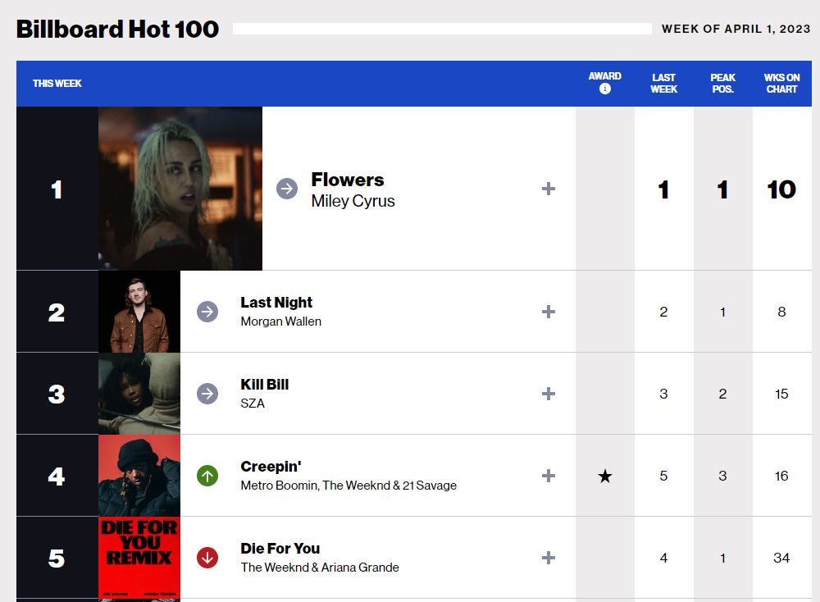
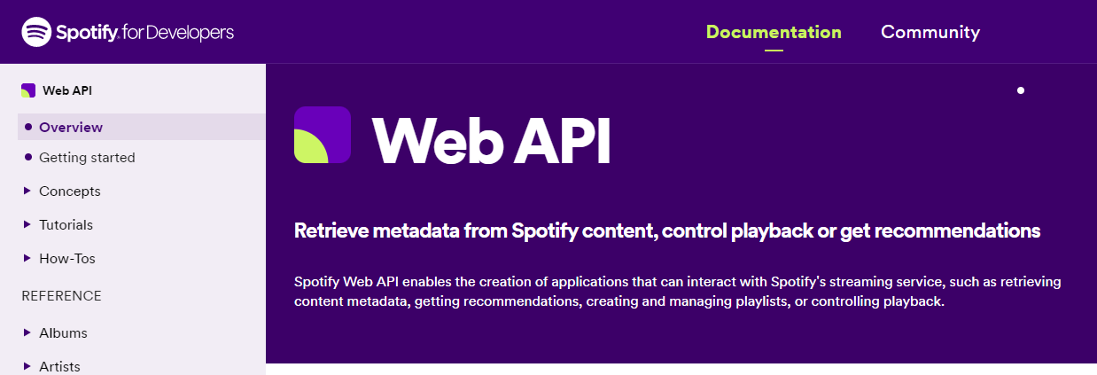
Data Sources
&
The Billboard Hot 100 (1958 – 2021) – from Kaggle dataset
Song metadata from Spotify Web API

Slide 3
Motivation & Related Work

Slide 4
Psychological/Neurological Importance
Natural predisposition to interpretation of sounds
Not just humans (animals have alert calls for instance)
Slow, classical music → calmness & relaxation
Car horn → alert & fear
Music producers exploit these interpretations to convey emotion in songs
We like songs that we can ultimately “predict” (i.e. not too surprising)
Expectations may be challenged but successful songs go back to “comfort”
Songs leave imprints in our brains for future reference
(Very High Level) Summary: the music we like has recognizable patterns that slowly evolve over time!

Slide 5
Business Cases
Recommendation Algorithms, including:
Related Artists (‘if you liked artist X, you’ll probably like artist Y’)
Discover (recommending new songs you might not have seen otherwise)
Browse (how the songs are displayed to you)
Record Labels
Could find unsigned artists with potential to be next star (ex. Snafu Records)
AI-Generated Music (ex. Amper Music, OpenAI MuseNet, etc.)
Scan patterns in chords, tempo, length, etc. to generate original melodies
(Very High Level) Summary: music feature data can be used to find, recommend, and even create new music!

Slide 6
Methodology

Slide 7
Overall Process
Use Billboard Top 100 list to find popular songs over the last several decades (1958-2021), peak chart rank, and weeks on the chart.
Use Spotify Web API to retrieve audio features.
Basic data analysis to understand what might be worth investigating.
Distribution of features (histograms), plot features over time, correlation between different features
Classifying what kind of songs become popular.
K-Means clusters to see if distinct groups of songs become popular
Word clouds to visually represent the most popular genres of each cluster
Attempting to predict if a song will be popular.
Logistic Regression for Binary Classification (i.e. “popular” or “not popular”)
Try to observe important traits associated with popularity prediction.

Slide 8
Audio Features
Feature | Description | Scale
Acousticness | ‘Real’ instruments (instead of electronic) | 0 – 1 (1 = 100% acoustic)
Danceability | How suitable is the track for dancing? | 0 – 1 (1 = most danceable)
Energy | Perceived intensity; fast/loud/noisy | 0 – 1 (1 = highest energy)
Instrumentalness | Does the track have vocals? | 0 – 1 (< 0.5 means instrumental track)
Key | Integers mapping to Standard Pitch Class notation | -1 – 11 (-1 = no key, 0 = C, 1 = C#, etc.)
Liveness | Was there an audience in the recording? | 0 – 1 (> 0.8 means very likely an audience)

Slide 9
Audio Features
Feature | Description | Scale
Loudness | Average loudness in dB for the track. | -60 db – 0 db (typically)
Mode | Is track major or minor? | 0 = minor, or 1 = major
Speechiness | Are there spoken words in the track? | 0 – 1 (1 means entirely spoken, no music)
Tempo | Beats per minute (BPM); speed/pace of the track | 50 – 200 (typically)
Time Signature | How many beats per bar? | 3 – 7 (ex. 3 means a time signature of 3/4)
Valence | How positive (happy, cheerful) is the track? | 0 – 1 (1 is most positive)
Popularity | Calculated by Spotify to indicate how popular a track is currently. | 0 – 100 (100 = the most popular songs today)

Slide 10
Descriptive Statistics
 | danceability | energy | loudness | speechiness | acousticness | instrumentalness | liveness | valence | tempo | duration_ms | time_signature
Mean | 0.6 | 0.6 | -8.5 | 0.1 | 0.3 | 0.0 | 0.2 | 0.6 | 120.3 | 227340.7 | 3.9
Median | 0.6 | 0.6 | -8.0 | 0.0 | 0.2 | 0.0 | 0.1 | 0.6 | 119.0 | 222566.5 | 4.0
Std Dev | 0.2 | 0.2 | 3.6 | 0.1 | 0.3 | 0.2 | 0.2 | 0.2 | 28.1 | 67409.7 | 0.3
Mean = 3:45
Sd = 1 minute
Chart Listings (song, week, rank): 329,438 entries
Distinct Songs: 28,484
Distinct Artists: 9,124

Slide 11
Results

Slide 12
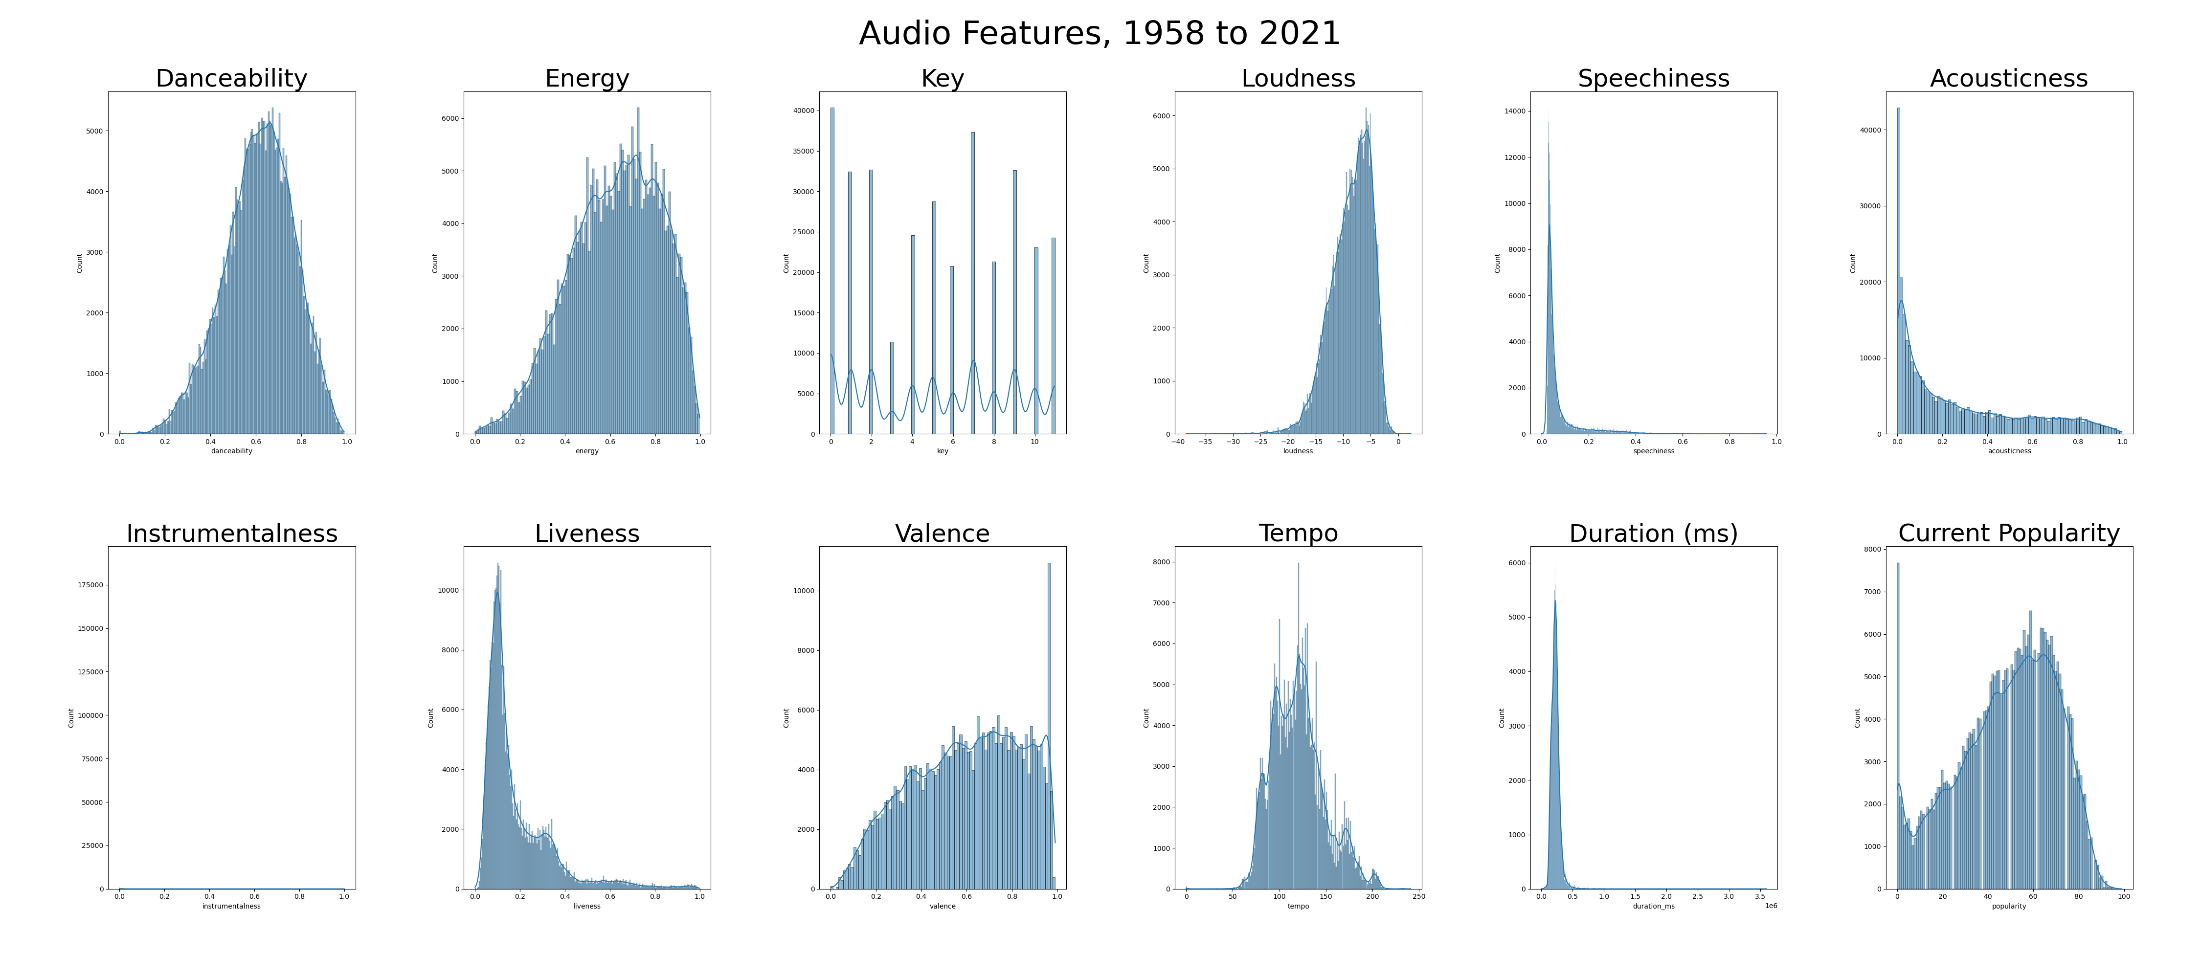
Histograms

Slide 13
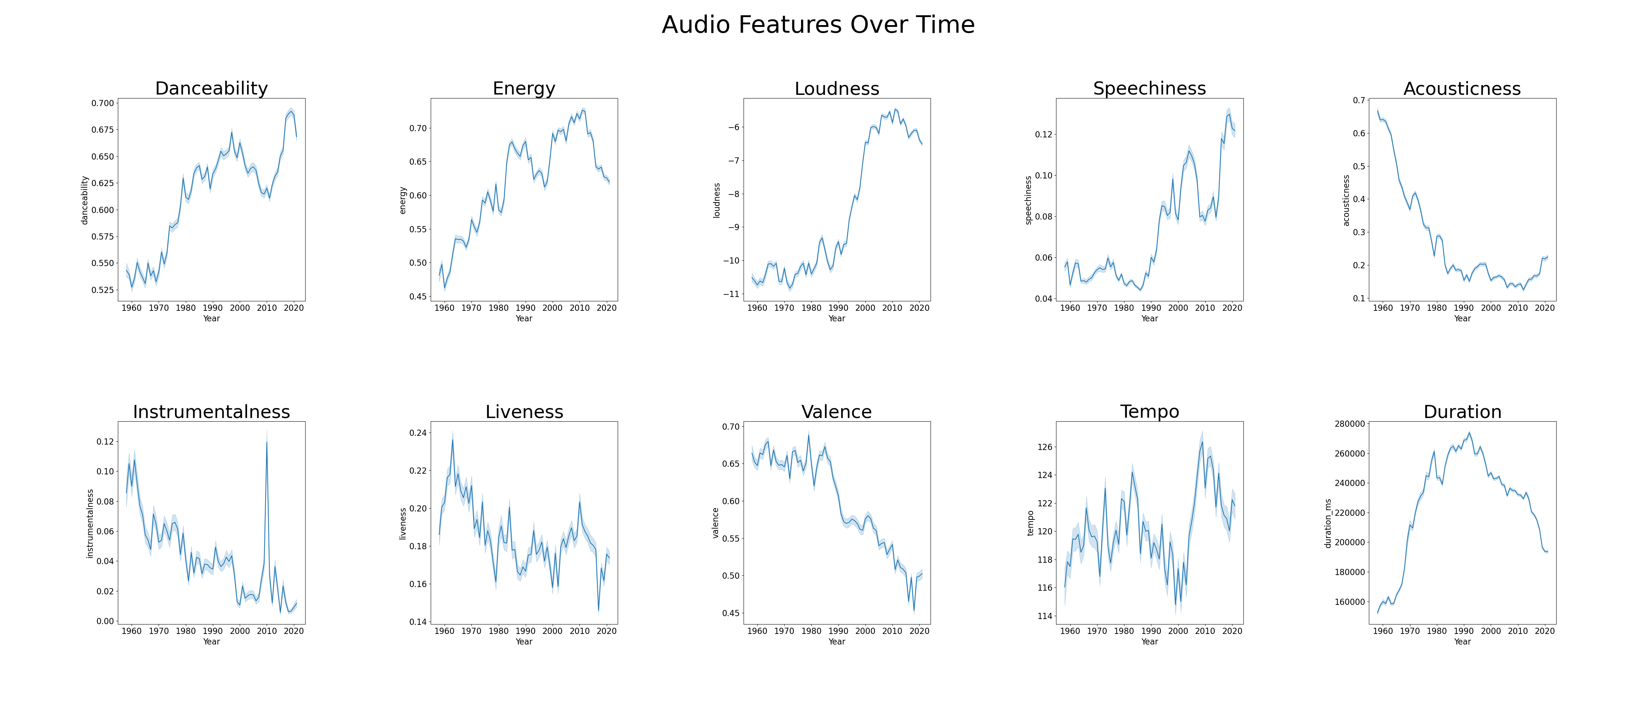

Slide 14
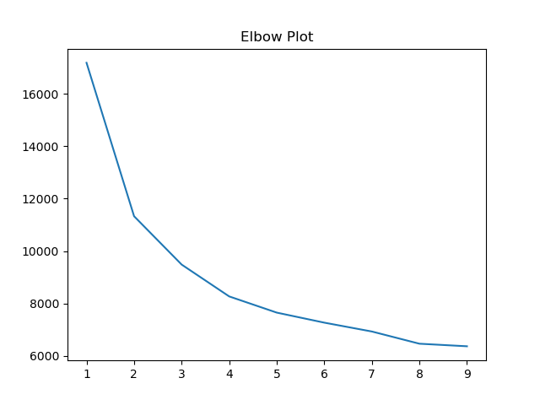
Characterizing Songs: K-Means Clustering
Use “Elbow Method” heuristic to determine the number of clusters in the set of distinct songs
Plot of explained variation against number of clusters
I chose 4 different clusters
The “elbow” is in
this region

Slide 15
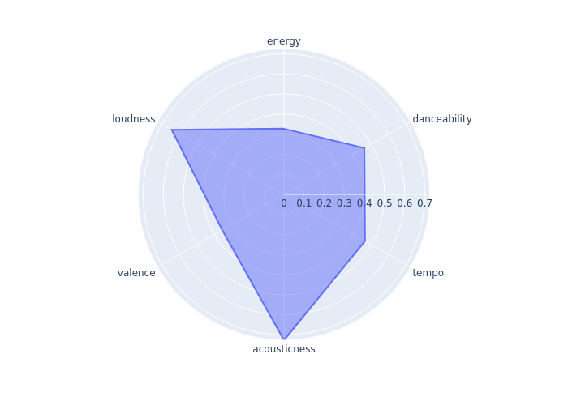
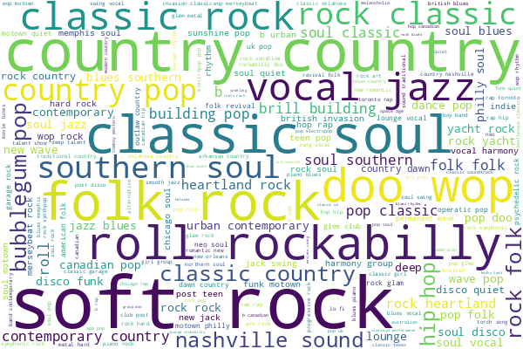
Cluster 1: “Calm / Natural Instruments”
N = 4586
Popular Examples:
“Someone You Loved”
Lewis Capaldi
“lovely”
Billie Eilish & Khalid
“When I Was Your Man”
Bruno Mars

Slide 16
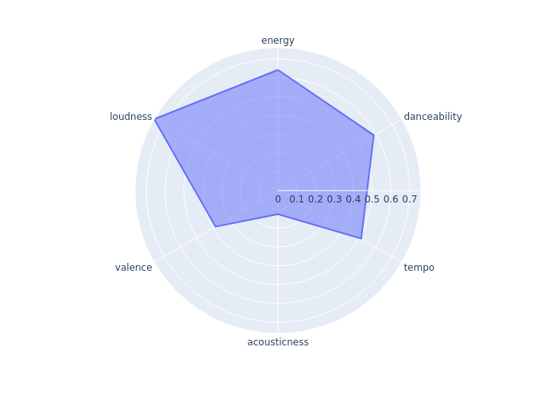
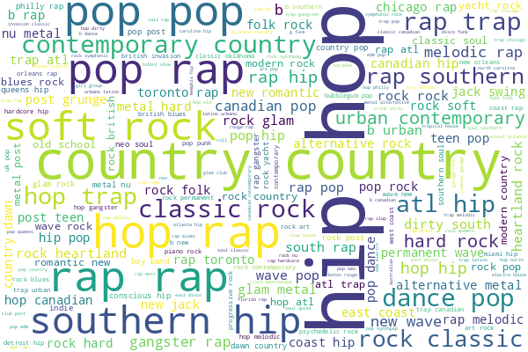
Cluster 2: “Intense, More Electronic Instruments”
N = 7987
Popular Examples:
“Blinding Lights”
The Weeknd
“Mockingbird”
Eminem
“Sweater Weather”
The Neighborhood

Slide 17
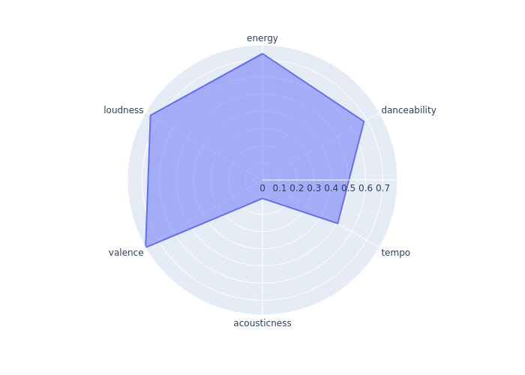
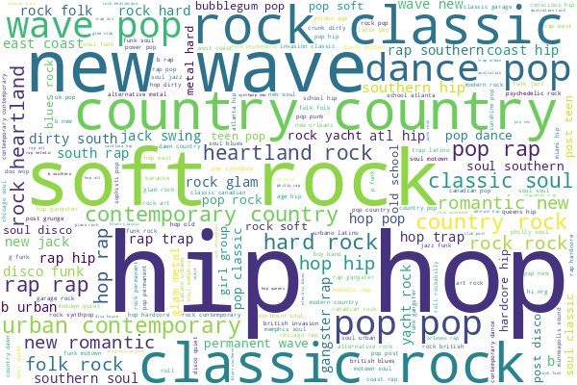
Cluster 3: “Dance & Electronic Music”
N = 10362
Popular Examples:
“Save Your Tears”
The Weeknd
“Believer”
Imagine Dragons
“Shivers”
Ed Sheeran

Slide 18
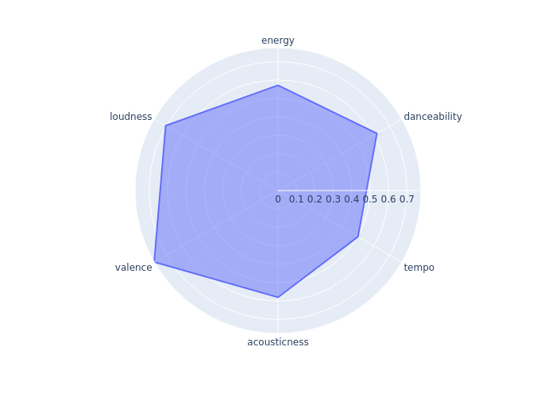
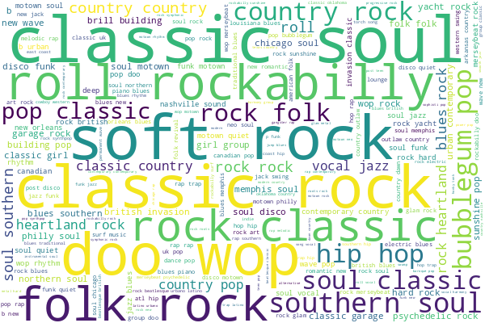
Cluster 4: “Upbeat / Natural Instruments”
N = 5547
Popular Examples:
“Toto”
Africa
“Every Breath You Take”
The Police
“Shape of You”
Ed Sheeran

Slide 19
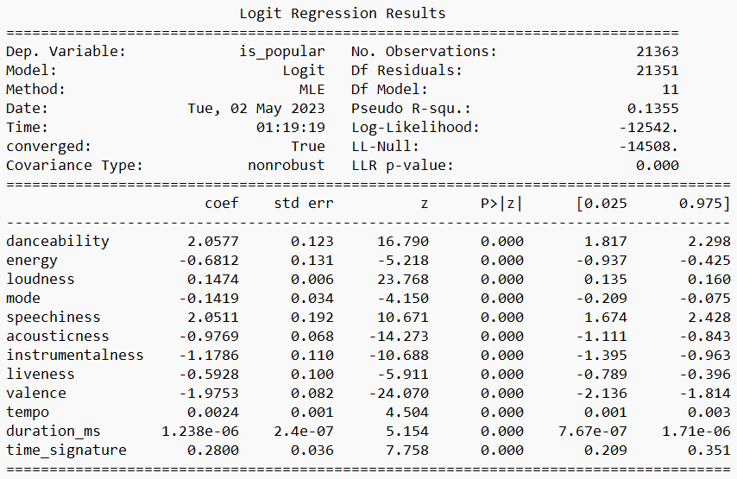
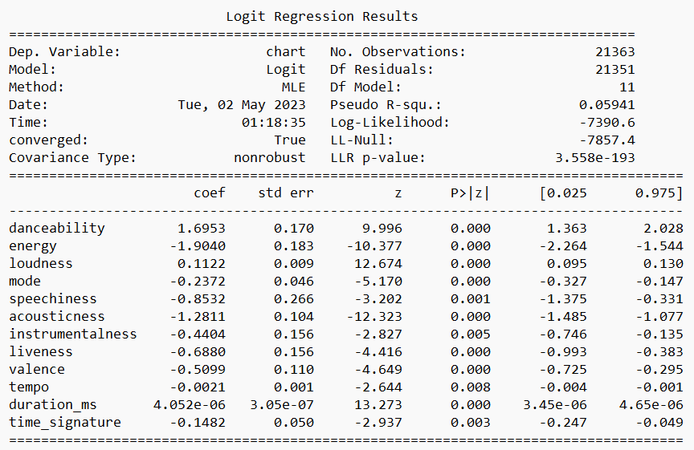
2 Different Approaches to Predicting A Song’s Popularity
1. Classify based on Spotify “Popularity” measure
2. Overlap of top quartile of peak rank & weeks on chart

Slide 20
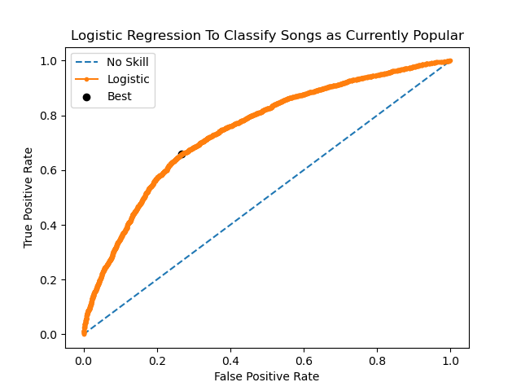
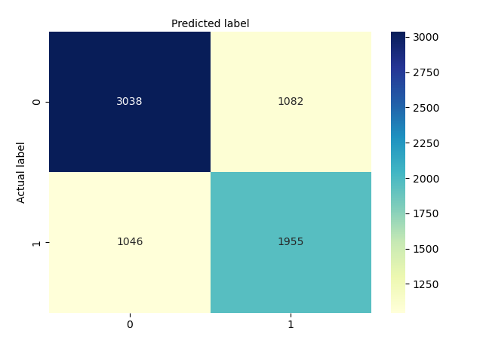
Predicting a Song’s Current Popularity
AUC = 0.746

Slide 21
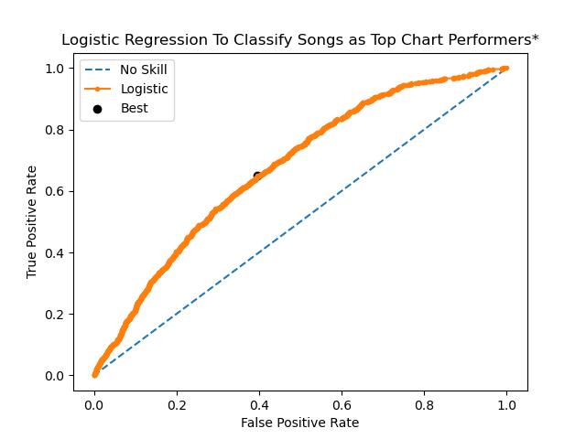
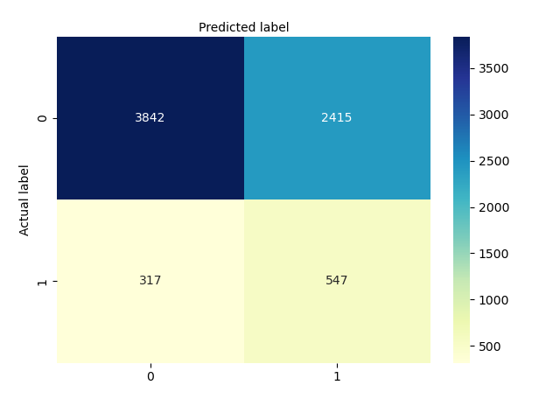
Predicting a Song’s Chart Performance*
AUC = 0.676

Slide 22
Observations

Slide 23
Observations
Evolution over time:
Increase in: Danceability, Energy, Loudness, Speechiness
Decrease in: Acousticness, Valence, Duration (down 1:20 from 1990’s peak)
Some overlap between clusters 1,4 and 2,3
Different interpretations of elbow method
Predictions
Popularity:
Logistic model has good accuracy in both directions
Largest coefficients: danceability, speechiness, valence, energy
Chart Performance:
Logistic model can predict with high accuracy if a song won’t be popular
Largest coefficients: danceability, energy, acousticness, speechiness

Slide 24
Questions?
Thank you!

Slide 25
